Slide 1
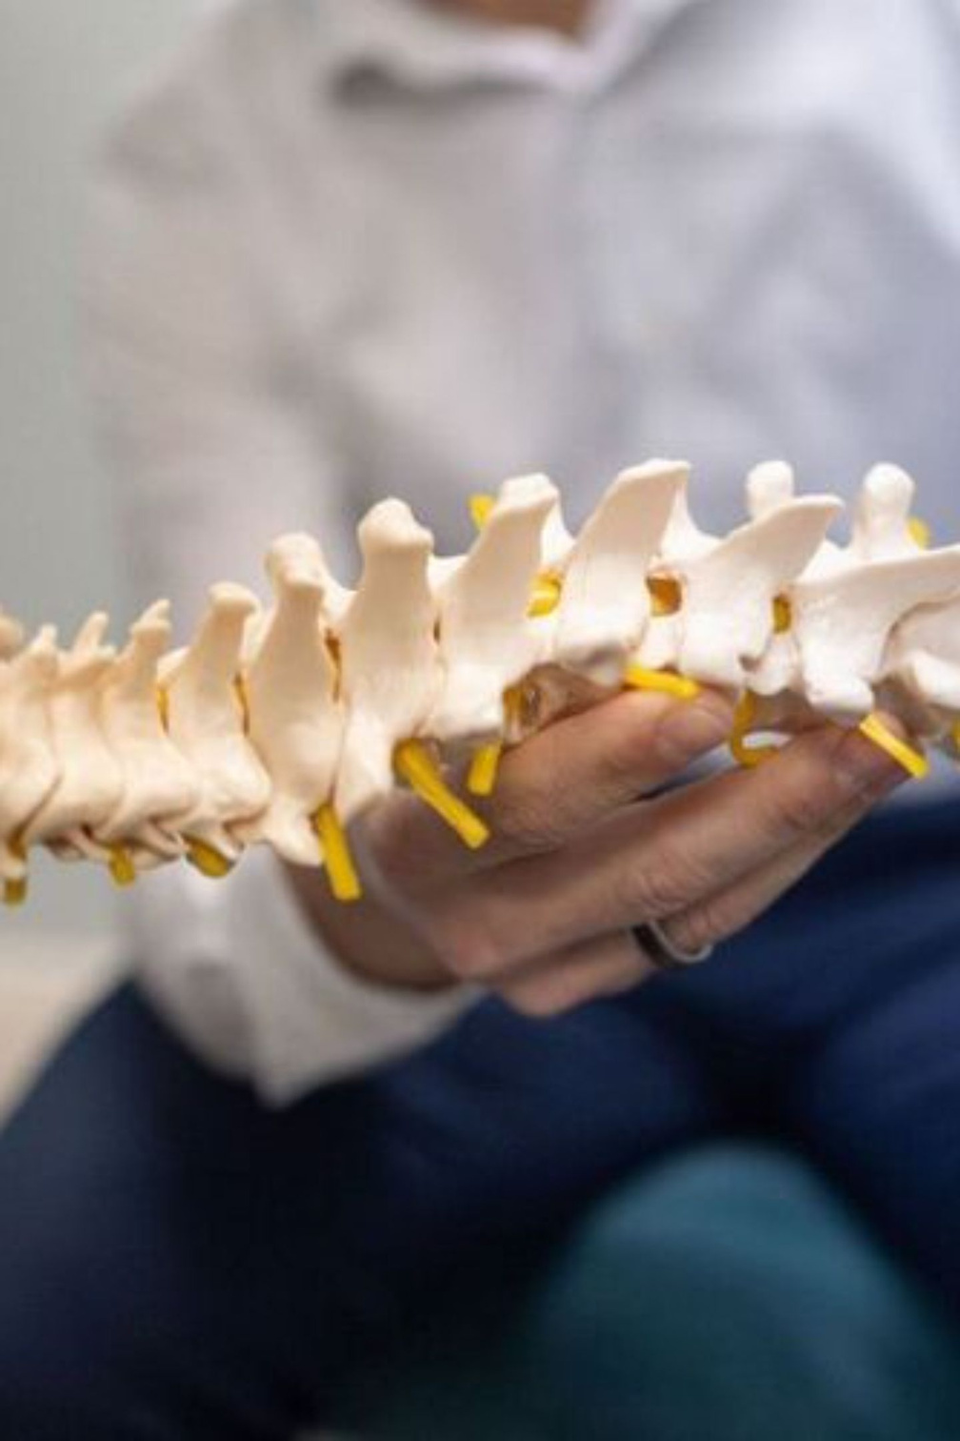

Numbness & Tingling: When to Seek Chiropractic Care in Ithaca
Your body sends signals for a reason. Learn when persistent numbness and tingling means it's time to see a professional — right here in Ithaca, NY.
Notes:
1

Slide 2



Understanding Numbness and Tingling
What It Feels Like
Unusual, uncomfortable sensations often described as "pins and needles" — may occur in fingers, hands, arms, or other body parts.
When It's Normal
Occasional tingling from prolonged positioning — like sitting cross-legged — is a common, temporary experience.
When to Pay Attention
Repeated or persistent symptoms warrant professional evaluation. Your body is communicating something worth listening to.
Notes:
2

Slide 3

Common Causes of Nerve-Related Discomfort
Nerve Pressure
Irritation, squeezing, or compression on nerves disrupts normal sensation.
Postural Issues
Poor posture during extended desk work places chronic stress on the spine.
Muscle Tension
Tight muscles can stress and impinge nearby nerves over time.
Injuries & Spine Problems
Trauma from accidents or sports, and spinal misalignment, can directly affect nerve function.
Notes:
3

Slide 4

5 Signs It's Time to See a Chiropractor
If you're experiencing any of the following, don't wait — a professional evaluation can make all the difference.
1
Tingling persists despite position changes
When shifting how you sit or stand doesn't relieve the sensation, something deeper may be at play.
2
Unexplained hand tingling with no clear cause
Numbness that appears without an obvious trigger deserves professional attention.
3
Pain or discomfort accompanying numbness
When tingling is paired with aching or sharp pain, nerve involvement is more likely.
4
Weakness in hands, arms, or grip strength
Functional loss alongside numbness is a key indicator that evaluation is needed.
5
Symptoms interfering with work, exercise, or sleep
When daily life is affected, it's time to act.
Notes:
4

Slide 5

What a Chiropractor Evaluates
A thorough chiropractic assessment goes beyond the symptom itself. Your chiropractor examines the full picture to identify the root cause of your discomfort.
Spine Alignment
Posture & Movement
Structural integrity and vertebral positioning
How your body holds and moves through daily activities
Joint Mobility
Nerve Function
Range of motion and areas of restriction
Indicators of compression, irritation, or dysfunction
Notes:
5

Slide 6



Chiropractic Care Treatment Options
Spinal Adjustments
Therapeutic Exercises
Posture Correction
Gentle corrections to restore proper alignment and relieve nerve pressure.
Practical guidance for better alignment during daily activities.
Targeted movements designed to build strength and restore mobility.
Lifestyle Modifications
Referrals
Targeted changes to reduce physical stress on nerves and joints.
Coordination with other healthcare providers when additional care is needed.
Notes:
6

Slide 7

Your First Chiropractic Visit
Knowing what to expect makes your first appointment easier. Here's how a typical initial visit unfolds:
Physical Assessment
Initial Consultation
Diagnostic Review
Personalized Plan
Every care plan is tailored to your unique symptoms, lifestyle, and goals — no one-size-fits-all approach.
Notes:
7

Slide 8



Don't Ignore Persistent Symptoms
Symptoms that are worsening or spreading are your body's way of asking for help. Early evaluation prevents complications down the road.
Early professional evaluation prevents complications. The sooner you act, the more options you have.
Increasing Frequency
Spreading Numbness
Grip Difficulty
Strength Changes
Trouble holding or gripping everyday objects
Noticeable shifts in movement ability or muscle strength
Tingling sensations occurring more often than before
Symptoms moving into new areas of the body
Notes:
8

Slide 9

Take Action Today
Numbness and tingling are your body's warning signals — and they deserve to be taken seriously.
Listen to Your Body
These sensations are meaningful signals, not inconveniences to push through.
Find the Root Cause
Professional guidance identifies what's driving your symptoms — not just masking them.
Evidence-Based Care
Chiropractic treatment offers proven, non-invasive options for nerve-related discomfort.
Ithaca, NY — Start Here
Don't wait. Schedule your evaluation with a local Ithaca chiropractor and reclaim your comfort and quality of life.
Notes:
9

Slide 10


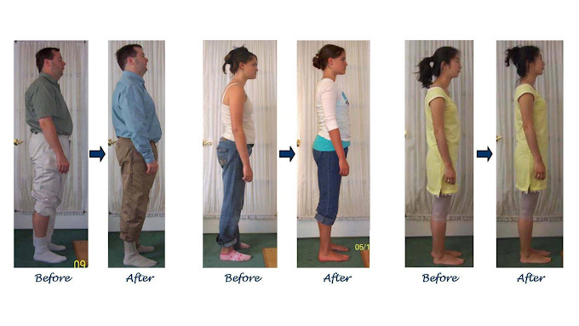
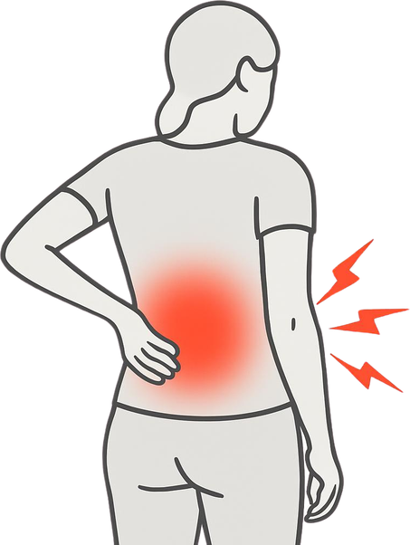
www.spinalwellnessithaca.com
Thank
You
We help people improve their posture, resolve chronic ailments, move easier and live a pain-free life. Our team at the Spinal Wellness Center of Ithaca is here to help you achieve your health goals. We are confident many of you can achieve greater levels of health and performance than you have been led to believe. We are finding and freeing things in the body that many health care professionals overlook.
For More Information Contact Us :
Website: www.spinalwellnessithaca.com
Name: Spinal Wellness Center of Ithaca
Phone: 607-277-2570
Location: 114 1/2 W. Buffalo Street
Ithaca, NY 14850

